Slide 1

Route Availability prediction
Wiktor Jakubowski
Mikołaj Gałkowski
Hubert Bujakowski
Łukasz Tomaszewski
Maja Andrzejczuk

Slide 2

Concept
Task: route availability prediction
Data: historical data about meteorological conditions and flight details
Solution:
train advanced machine learning model predicting possibility of arrival & departures within given airports
create web application to visualize routing, possible connections for future flights.
presented application can be used by airlines on daily and by consumers for flight information.

Slide 3
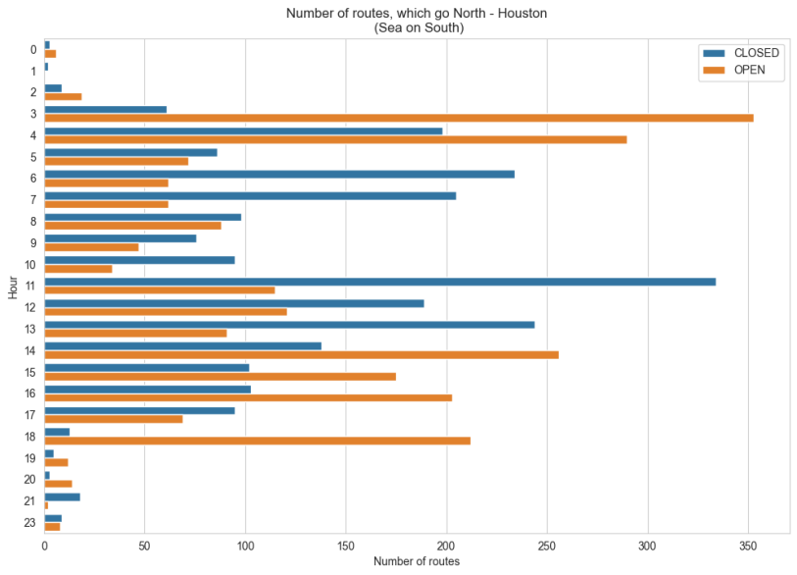
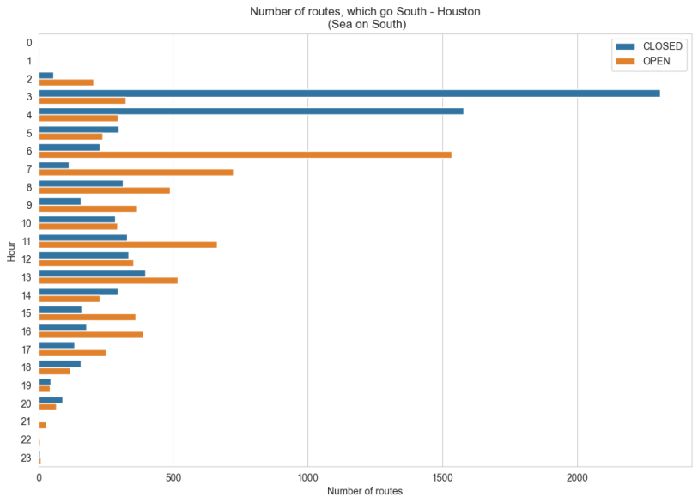

Slide 4
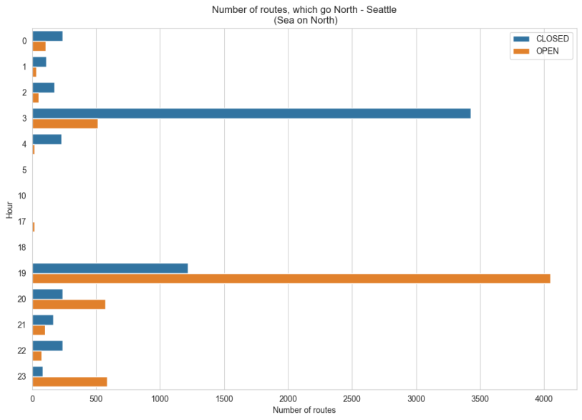
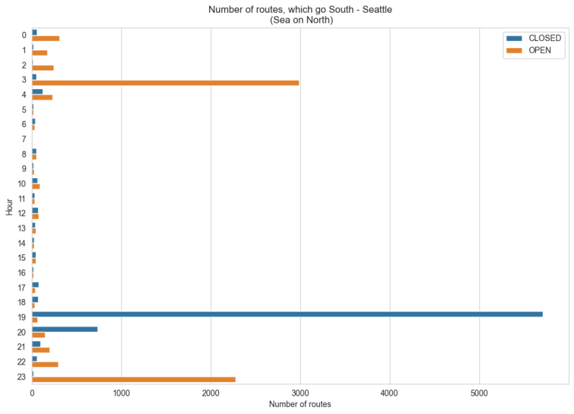

Slide 5
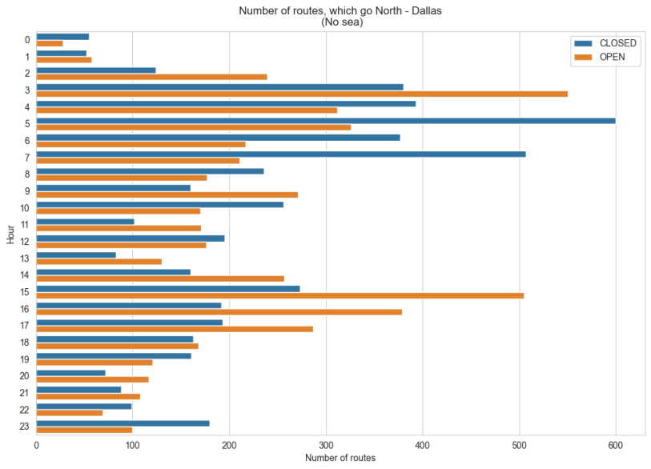
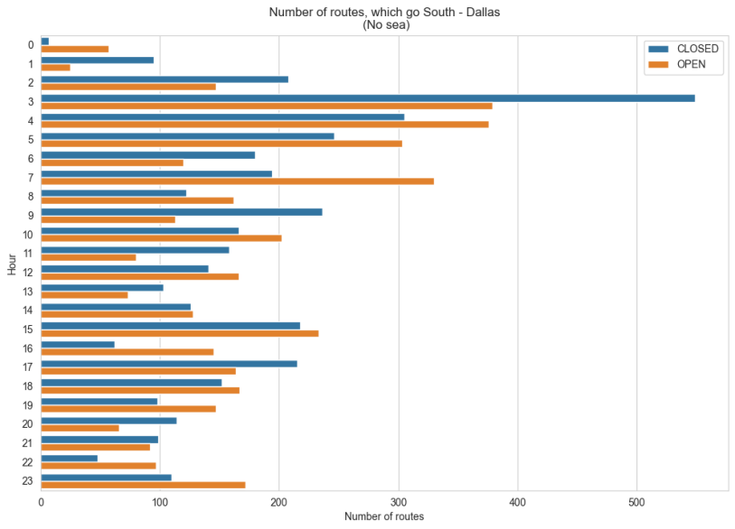

Slide 6

Preprocessing
Flights details data:
Encoding categorial features (flight status, airport, route type)
Dropping unimportant features
Weather data:
Map coordinates to matrix indices
Extrapolation of waypoints vector
Vincinity analysis of weather in waypoints

Slide 7

Feature engineering
Waypoint informations:
Flight direction (north/west)
Distance in kilometers from arrival to destination
Coverage of waypoints coordinates with current weather conditions along the flight route
Flights details data:
extracting the day of the week from the date

Slide 8

Results
Used algorithm – LightGBM
Optimized parameters included learning rate, number of estimators etc.
Final model f1 score was 0.73 on independent dataset
Model used in application in order to predict value of a customer's desired flight

Slide 9
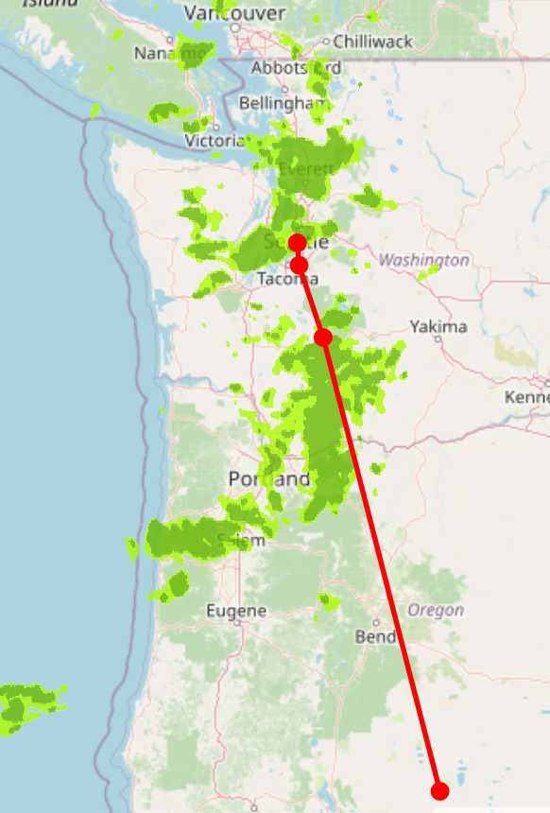
Solution
Visualizing the trace of certain flight.
Show if given route is possible
Compare departure options depending on flight time and day

